Slide 1

Missing Persons in the USA
KU Boot camp Group Project 2
Team: Jemi, Sanita, Randall, Tom
June 2020

Slide 2

System Components
Data Visualization
Index.html
Chart.htmll
Flask
Python code
Connects to Postgres
Retrieves data from Postgres
Serves data in json format via endpoints
Landing Page
Index.html
Database
Postgres
Flask
app.py
Data Visualization
xxx.js
Data files
xxx.csv
Data Sources
Missing_persons.csv
Census data
Data Visualization
Java Scripts
d3.geomap
D3js

Slide 3
Overview
What’s the Deal with Missing Persons???
Over 99% of missing persons are found or return home within 48 hours.
A person remains on the missing persons file until they are found dead or alive.
The missing persons file has information into 2018, but we limited it through 2017.

Slide 4
Data Munging
Import csv files for missing persons data and population data.
Combine, transform, parse and map data into formats for specific analyses.
Identified null values to be removed
Removed unnecessary columns
Limited some data to 1990 forward due to 15 million rows of data
Schema developed in postgres for further filtering.
Flask app created to render html and sql api.
Choropleth colors were pre-computed rather than numbers being used for each state for each year to speed up the data updates.

Slide 5
Challenges
Learning to load fwf file with no heading
Population data had numbers representing values, such as 1 = Male, 2= Female...making the data difficult to analyze, and for this reason we had to replace the numerical values with the true value. We assume this was done to reduce space.
Flask errors that resulted from null values called by improper sql joins.
Census data changing formats and information during the study period, resulting in limited probability comparisons.
Different files using different descriptors for the same item (e.g. Native American vs. Native Indian)
Radar Chart (Chartjs library) loading library issues – needed npm or bower to install. Pip nor conda installs worked.
Choropleth map of missing number per states was giving correct results for all but 2 states; we were never able to figure out why the fill colors were skipped for these 2 states (TN and VA).

Slide 6
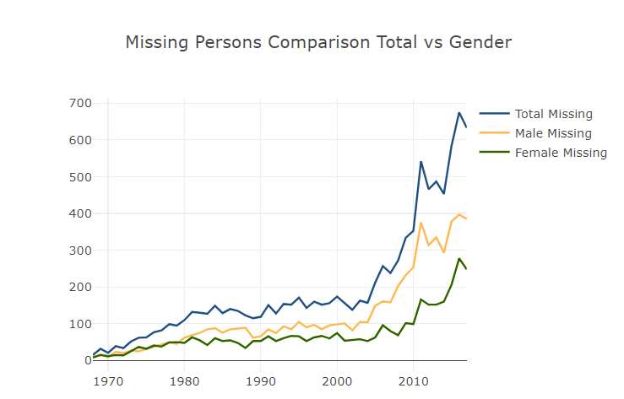
Missing Persons By Gender
And Year of Disappearance

Slide 7
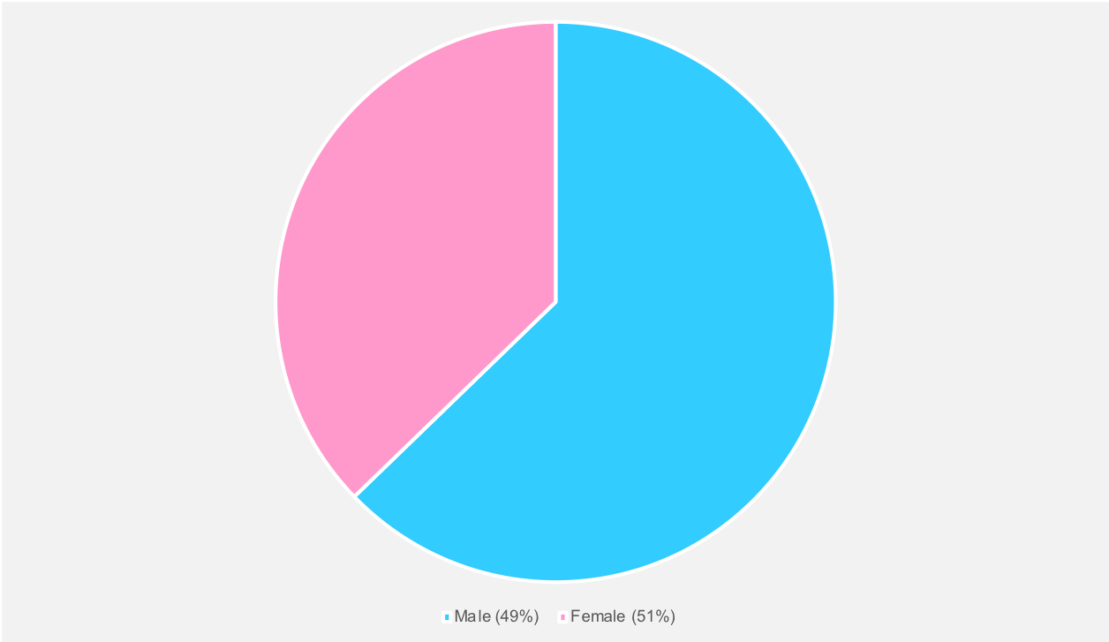
Missing Persons by Gender

Slide 8
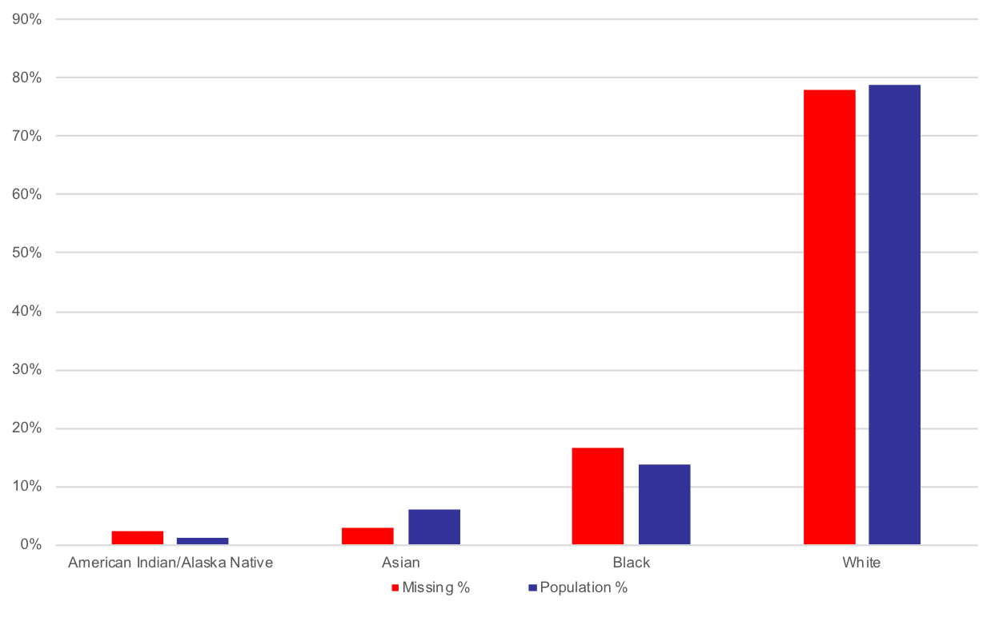
Missing Persons by Race

Slide 9
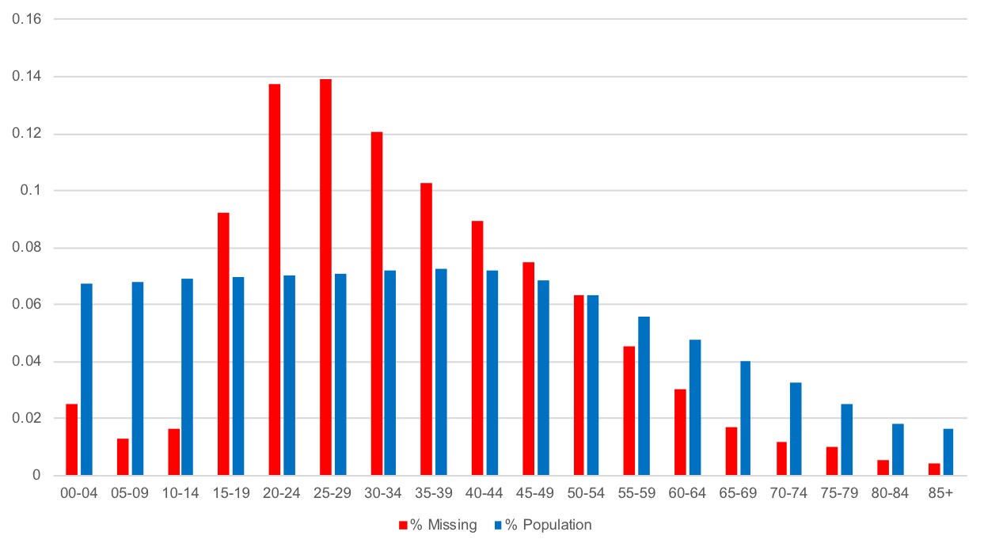
Missing Persons by Age Group

Slide 10
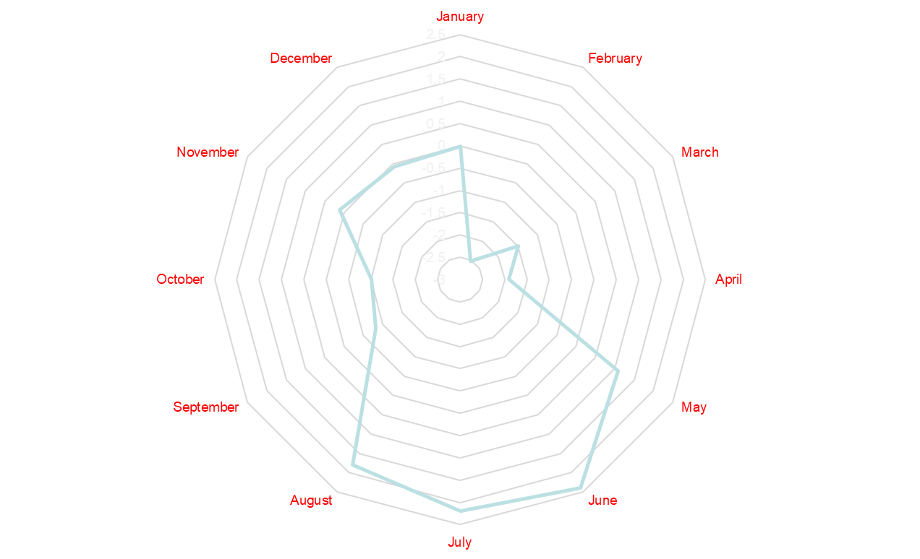
Seasonality of Unresolved Disappearances

Slide 11
Missing Persons by State
The following are samples of choropleths available for decades ending each year from 1977 through 2017.
Based on rate of missing persons per population
The colors range from red to blue.
Red being over 10 times the national average rate.
Blue is less than 30% of the national average rate.
A logarithmic scale was used, since Alaska would have dominated any linear scale.
Alaska is the biggest outlier
The less populated western areas tend to have higher rates
Arizona has been steadily rising in missing persons.

Slide 12
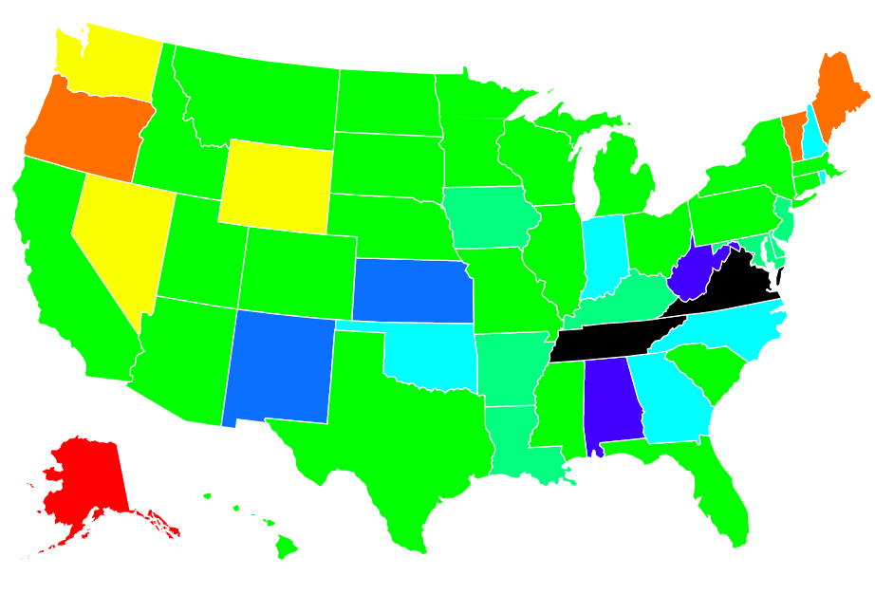
Missing Persons Rate - Decade
Ending 1977

Slide 13
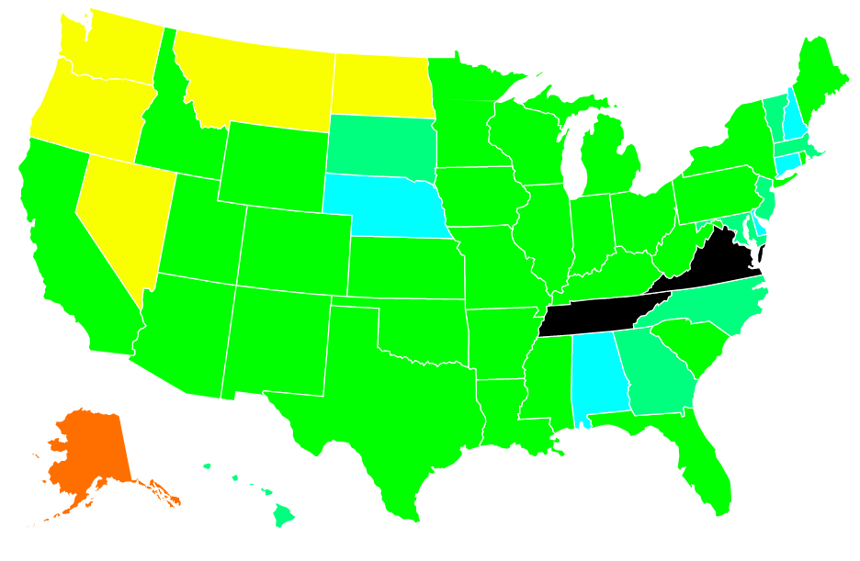
Missing Persons Rate - Decade
Ending 1997

Slide 14
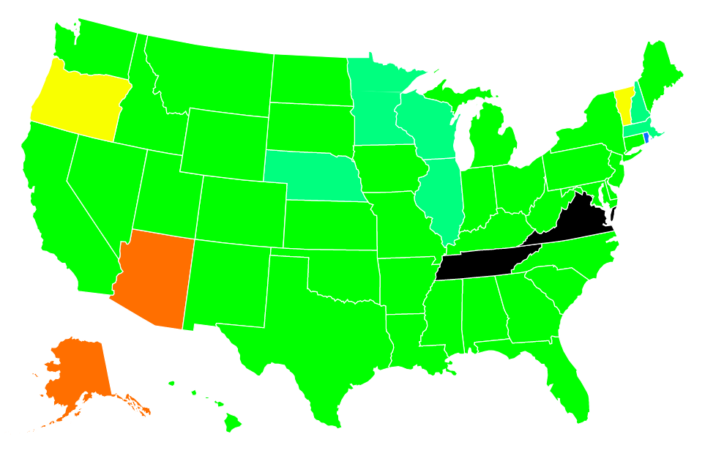
Missing Persons Rate - Decade
Ending 2017

Slide 15
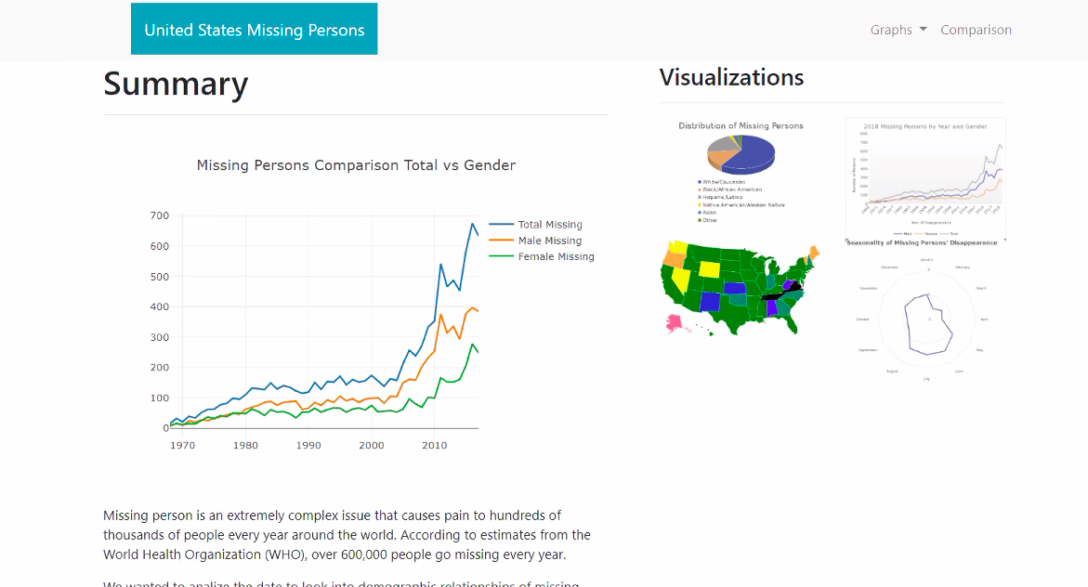
Website Screenshot

Slide 16
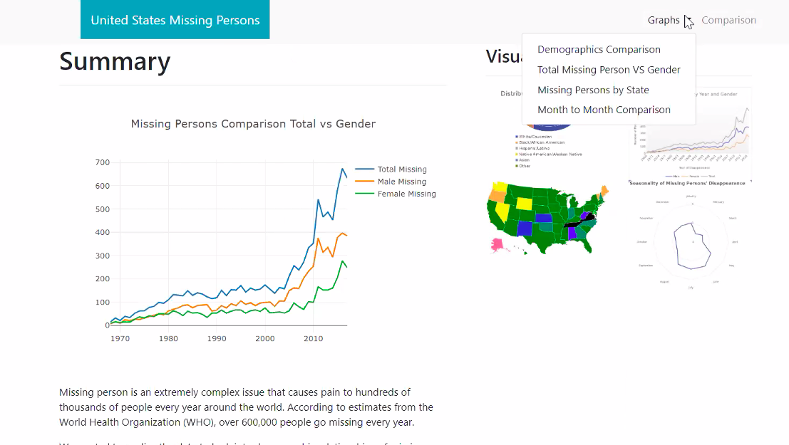
Website Screenshot

Slide 17
Conclusions
    Males are more likely than females to be missing persons.
    Native Americans and Blacks have higher than normal rates of disappearance.
    Asian-Americans have very low relative rates of disappearance.
    Individuals in the late teens to early thirties are disproportionately likely to become missing.
    Missing people tend to disappear in warmer months, with a modest increase in the winter during the holidays.
    More sparsely populated states generally have higher rates of disappearance, but missing persons are tending to normalized toward the national average.

